Slide 1
“She likes” vs “He likes”

Slide 2
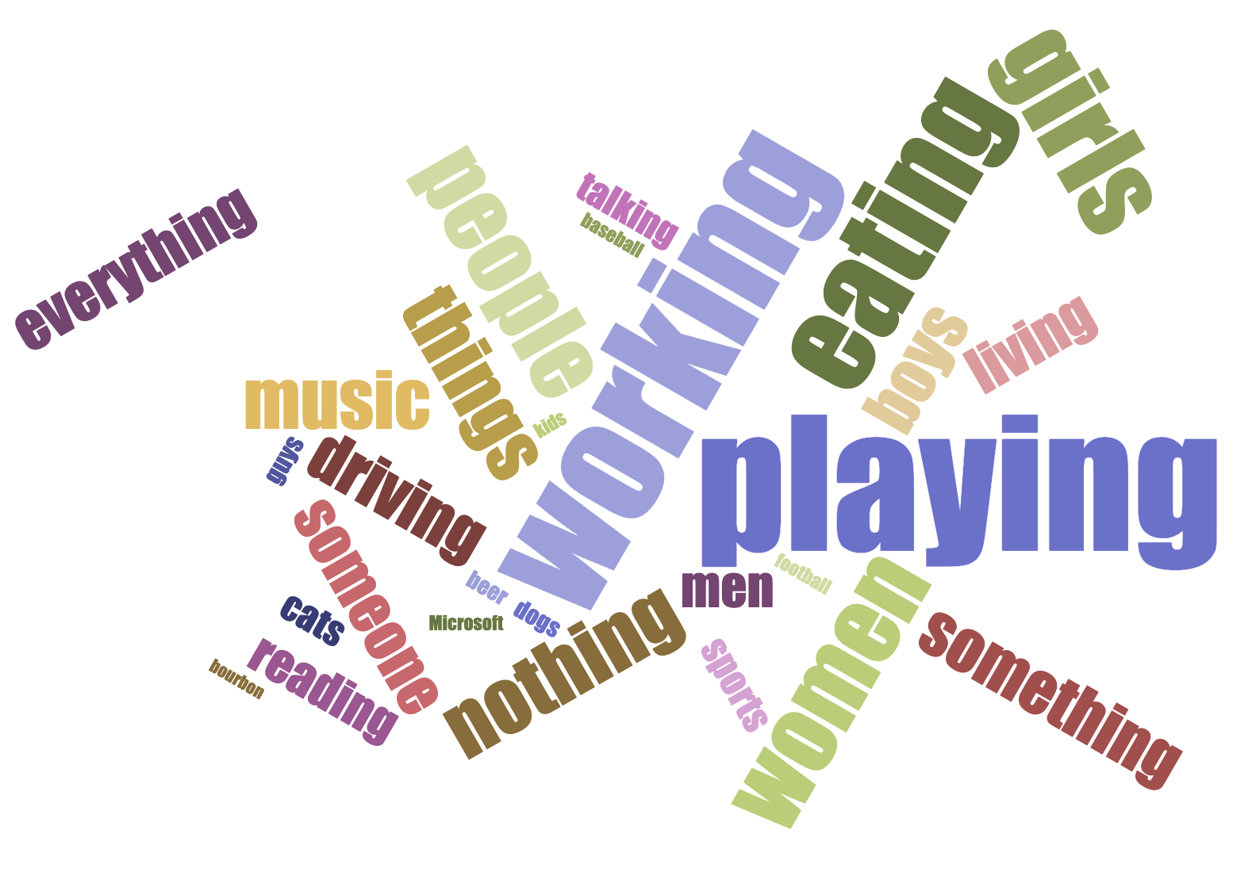
He likes…

Slide 3
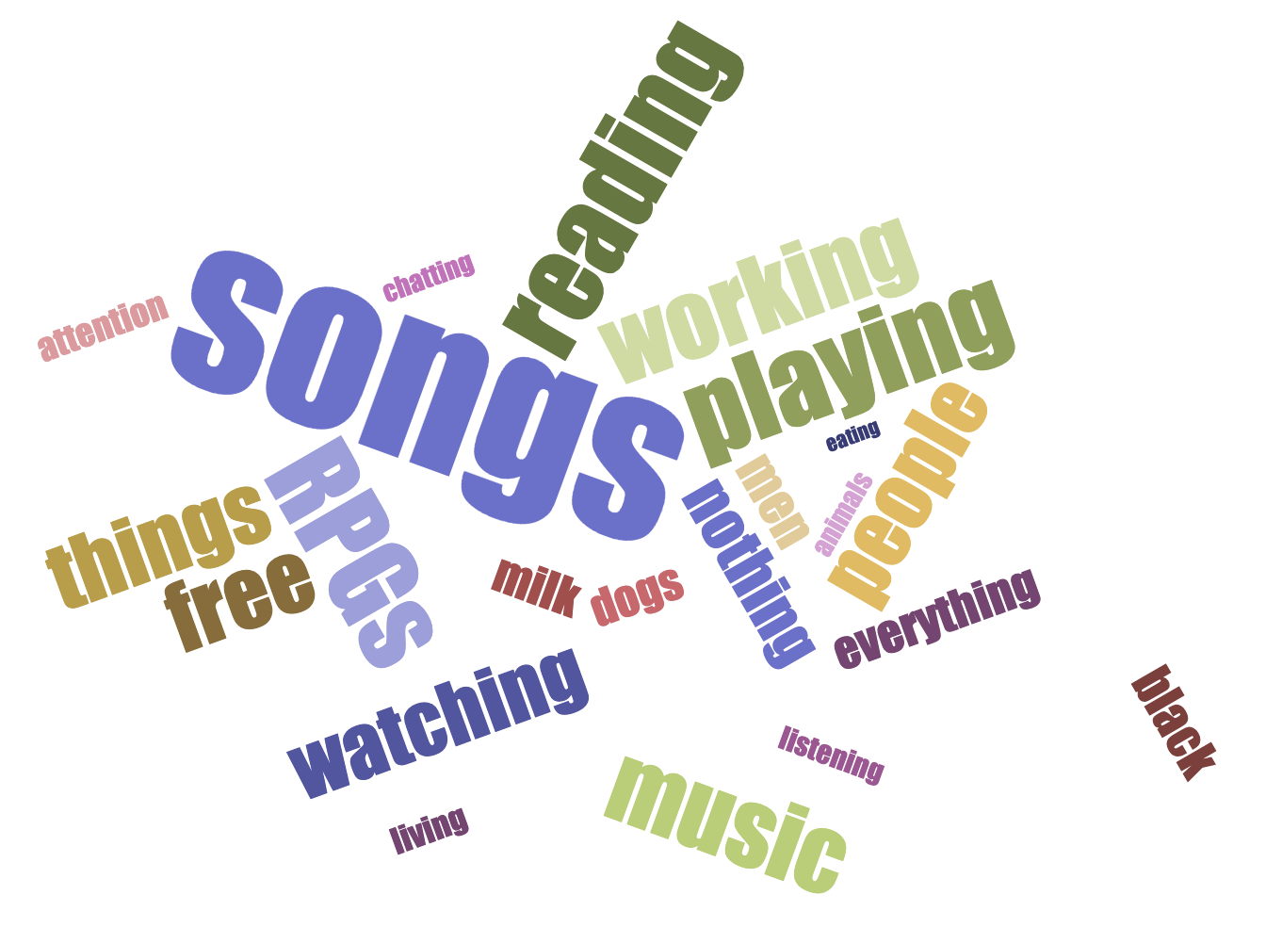
She likes…

Slide 4
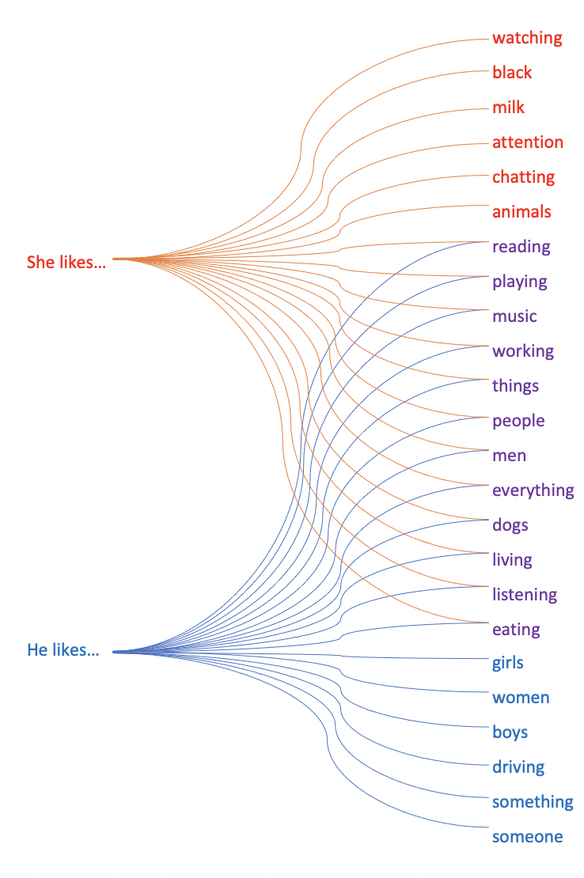
“She likes…” vs “He likes…”

